Slide 1
Section 2.5: Miscellaneous Voting Methods
Math for Liberal Studies

Slide 2
More Methods
There are many more methods for determining the winner of an election with more than two candidates
We will only discuss a few more:
sequential pairwise voting
contingency voting
instant-runoff voting

Slide 3
Sequential Pairwise Voting
Idea: We like pairwise voting since we can use majority rule
If we look at all pairwise elections (Condorcet’s method), we sometimes don’t get a winner
In sequential pairwise voting, we put the candidates in order on a list, called an agenda

Slide 4
How It Works
We pit the first two candidates on the agenda against each other. The winner moves on to face the next candidate on the list, and so on. The candidate remaining at the end is the winner.
This process resembles a tournament bracket, and has the advantage that, unlike Condorcet’s method, we always get a winner

Slide 5
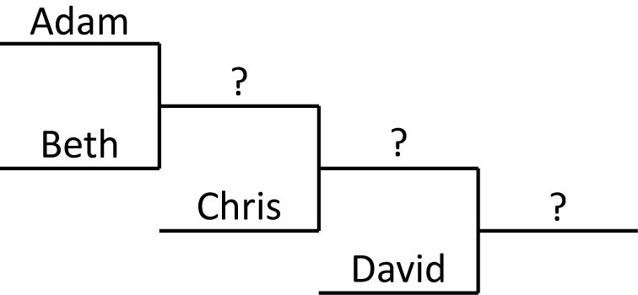
An Example
Let’s use sequential pairwise voting with this profile and the agenda Adam, Beth, Chris, David
Voters | Preference Order
4 | A > B > D > C
3 | C > A > B > D
3 | B > D > C > A

Slide 6
An Example
First we consider the Adam vs. Beth matchup
Voters | Preference Order
4 | A > B > D > C
3 | C > A > B > D
3 | B > D > C > A

Slide 7
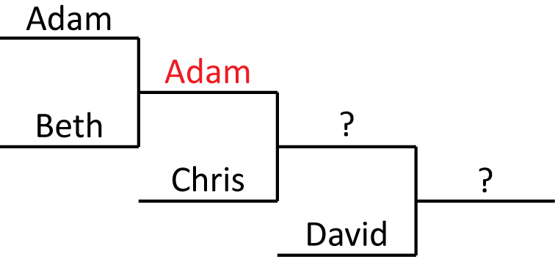
An Example
Adam wins, 7 to 3
So Adam moves on to face Chris
Voters | Preference Order
4 | A > B > D > C
3 | C > A > B > D
3 | B > D > C > A

Slide 8
An Example
Adam vs. Chris
Chris wins 6 to 4
Voters | Preference Order
4 | A > B > D > C
3 | C > A > B > D
3 | B > D > C > A

Slide 9
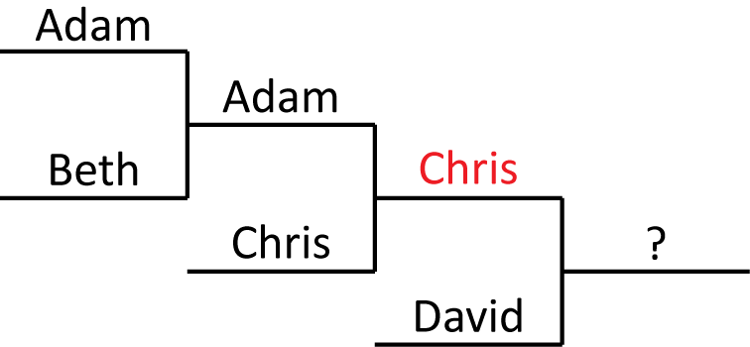
An Example
Adam vs. Chris
Chris wins 6 to 4
Voters | Preference Order
4 | A > B > D > C
3 | C > A > B > D
3 | B > D > C > A

Slide 10
An Example
The final matchup is Chris vs. David
David wins 7 to 3
Voters | Preference Order
4 | A > B > D > C
3 | C > A > B > D
3 | B > D > C > A

Slide 11
An Example
The final matchup is Chris vs. David
David wins 7 to 3
Voters | Preference Order
4 | A > B > D > C
3 | C > A > B > D
3 | B > D > C > A

Slide 12
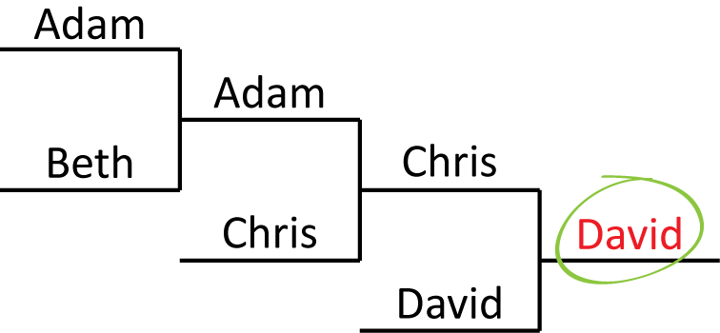
An Example
So David is the winner of the election
Voters | Preference Order
4 | A > B > D > C
3 | C > A > B > D
3 | B > D > C > A

Slide 13
Problems
If we look closely at this agenda, we notice that every single voter prefers B over D, and yet D was our winner!
If we had used the agenda B, D, C, A, the first matchup would be B vs. D, which B wins 10 to 0!
Voters | Preference Order
4 | A > B > D > C
3 | C > A > B > D
3 | B > D > C > A

Slide 14
Problems
In fact, by cleverly choosing the right agenda, we could make any of the four candidates win this election
Sequential pairwise voting does not satisfy the Pareto condition
Voters | Preference Order
4 | A > B > D > C
3 | C > A > B > D
3 | B > D > C > A

Slide 15
The Pareto Condition
If every single voter prefers one candidate over another, then the second candidate should not be the winner
Named for Vilfredo Pareto (1848-1923), Italian economist
Does plurality satisfy the Pareto condition?

Slide 16
Plurality and Pareto
If every voter in a plurality election prefers A over B, then how many first-place votes does B get?
Zero! Therefore B cannot be the winner
So plurality does satisfy the Pareto condition

Slide 17
Runoff Voting
A runoff election occurs after an initial election when a clear winner has not been decided.
Runoff elections are common in situations where there are three or more candidates and none of them get a majority of the votes.
For example, there was recently a runoff election during the 2008 Georgia Senate race.

Slide 18
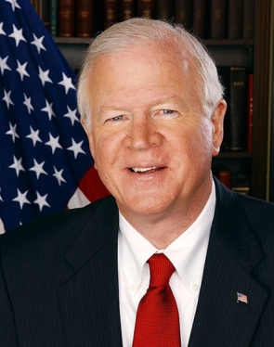
2008 Georgia Senate Race
There were three candidates:
Saxby Chambliss (R)
Jim Martin (D)
Allen Buckley (Libertarian)

Slide 19
2008 Georgia Senate Race
The results of the November election were
Chambliss 1,867,090 (49.8%)
Martin 1,757,419 (46.8%)
Buckley 128,002 (3.4%)
Chambliss was the plurality winner

Slide 20
2008 Georgia Senate Race
However, Georgia law mandates a runoff election when no candidate receives a majority
The runoff is a majority rule vote between the top two candidates
In this case, the runoff was in December between Chambliss and Martin

Slide 21
2008 Georgia Senate Race
Why did there need to be a second election? Couldn’t we just eliminate Buckley and use the existing votes?
Chambliss 1,867,090 (49.8%)
Martin 1,757,419 (46.8%)
Buckley 128,002 (3.4%)
If we do that, we disenfranchise 128,002 voters!

Slide 22
2008 Georgia Senate Race
There is no way to know who those 128,002 voters would have chosen with only Chambliss and Martin as their choices
The runoff election was held in early December 2008

Slide 23
2008 Georgia Senate Race
Since the runoff was only deciding this one contest, turnout was much lower than in November
Chambliss 1,228,033 (57.4%)
Martin 909,923 (42.6%)
Chambliss won his 2nd term in the Senate

Slide 24
Using Preferences for Runoffs
If the voters in Georgia had been asked for their full preference orders rather than just their top choice, then the second election would not have been necessary
We would know who the Buckley voters would have voted for, and the winner could have been calculated instantly

Slide 25
Contingent Voting
Voters rank all candidates in a preference order
If one candidate wins a majority of the first-place votes, then that candidate is the winner
If not, then we eliminate all candidates except the two who got the most first-place votes.
Then, using the full voter profile, the winner of an election between those two candidates is decided by majority rule.

Slide 26
An Example of Contingent Voting
Number of Voters | Preference
8 | C > A > B > D
6 | B > D > C > A
4 | A > C > D > B
3 | D > A > B > C
2 | C > A > D > B
Consider this profile
C has the most first place votes (10), but this is not a majority
The top two are B and C

Slide 27
An Example of Contingent Voting
Number of Voters | Preference
8 | C > A > B > D
6 | B > D > C > A
4 | A > C > D > B
3 | D > A > B > C
2 | C > A > D > B
We eliminate A and D
The winner of the B vs. C matchup is C (14 to 9)
So C is the contingency winner

Slide 28
Another Example
Contingent voting seems like a good method
However, it has a serious problem that we will see in the next example
Suppose we have an election with three candidates: Alison, Barbara, and Christine
We’ll use contingent voting to decide the winner

Slide 29
Another Example
Number of Voters | Preference
37 | A > B > C
35 | B > C > A
28 | C > A > B
Here is the voter profile
A has the most first place votes, but not a majority
The top two are A and B, so we eliminate C

Slide 30
Another Example
Number of Voters | Preference
37 | A > B > C
35 | B > C > A
28 | C > A > B
Here is the voter profile
A has the most first place votes, but not a majority
The top two are A and B, so we eliminate C
A wins the A vs. B matchup, 65 to 35

Slide 31
Another Example
Number of Voters | Preference
37 | A > B > C
35 | B > C > A
28 | C > A > B
Let’s suppose some time goes by, and now there is another election with the same candidates
This time, some of the voters who had B ranked first decide that they like A better now

Slide 32
Another Example
Number of Voters | Preference
37 | A > B > C
35 | B > C > A
28 | C > A > B
Suppose 10 voters who had preference B>C>A now have preference A>B>C

Slide 33
Another Example
Number of Voters | Preference
37 | A > B > C
35 | B > C > A
28 | C > A > B
Suppose 10 voters who had preference B>C>A now have preference A>B>C
+10
−10

Slide 34
Another Example
Number of Voters | Preference
47 | A > B > C
25 | B > C > A
28 | C > A > B
Suppose 10 voters who had preference B>C>A now have preference A>B>C
Notice that A has moved up on those ballots, but the other candidates stayed in the same order (B>C)

Slide 35
Another Example
Number of Voters | Preference
47 | A > B > C
25 | B > C > A
28 | C > A > B
Who wins now?
A now has 47 first place votes, but that still is not a majority
Now A and C are the top two, so eliminate B

Slide 36
Another Example
Number of Voters | Preference
47 | A > B > C
25 | B > C > A
28 | C > A > B
Who wins now?
A now has 47 first place votes, but that still is not a majority
Now A and C are the top two, so eliminate B
But now C wins the A vs. C matchup, 53 to 47!

Slide 37
What the %@$# happened?
By moving A higher on their ballots, those 10 voters caused A to lose the election!
This shows that contingent voting is not monotone

Slide 38
Monotone Again
Recall that we used the word “monotone” when we discussed two-candidate elections
With two candidates, monotone means:
if one or more voters change their votes from the loser to the winner, then the original winner should still be the winner

Slide 39
Monotone Again
Recall that we used the word “monotone” when we discussed two-candidate elections
With more than two candidates, monotone means:
if one or more voters change their ballot so that the original winner is ranked higher (but the order of the other candidates is not changed), then the original winner should still be the winner

Slide 40
Monotone Again
In our example, the original winner was Alison
Then some voters moved Alison from last place on their ballots up to first place, but kept the order of the other candidates the same
The result was that Alison was no longer the winner!

Slide 41
Another Method: Instant-Runoff Voting
This is a variation of the contingent method
Instead of eliminating all but the top two right away, we eliminate candidates one at a time

Slide 42
Instant-Runoff Voting
First check to see if any candidate has received a majority of the first-place votes
If not, then the candidate that received the fewest first-place votes is eliminated
Recalculate the voter preferences, and again check to see if a candidate now has a majority of the first-place votes.
If not, then repeat this process, eliminating candidates until one candidate has a majority.

Slide 43
An Example of Instant-Runoff
Voters | Preference Order
4 | A > B > C > D
3 | C > D > B > A
3 | B > C > D > A
2 | D > B > A > C
In this profile, A has 4 first-place votes, B has 3, C has 3, and D has 2
No candidate has a majority
So we eliminate the candidate in last place: D

Slide 44
An Example of Instant-Runoff
Voters | Preference Order
4 | A > B > C > D
3 | C > D > B > A
3 | B > C > D > A
2 | D > B > A > C
Now A has 4 votes, B has 5, and C has 3
Still no majority, so we eliminate C

Slide 45
An Example of Instant-Runoff
Voters | Preference Order
4 | A > B > C > D
3 | C > D > B > A
3 | B > C > D > A
2 | D > B > A > C
Finally we have A with 4 votes and B with 8
So B wins!

Slide 46
Dealing With Ties
If there is a tie for who to eliminate when you are using the instant-runoff method, eliminate all the tied candidates, unless this would eliminate everyone

Slide 47
Instant-Runoff Problems
Notice that with three candidates, contingent voting and instant-runoff voting are the same thing
Since we showed contingent voting isn’t monotone using an example with 3 candidates, that same example shows that instant-runoff also fails the monotone condition also

Slide 48
Enough Already!
We have studied many methods, and found problems with each one
Condorcet’s method sometimes doesn’t give a winner
Plurality voting fails the Condorcet winner criterion
Rank methods suffer from the spoiler effect
Sequential pairwise voting fails the Pareto condition
Runoff methods fail the monotone condition

Slide 49
Where do we go from here?
We could continue to search for a “fair” voting system that doesn’t suffer from any of these problems
We could also consider trying to use a different kind of ballot, since all of the systems we have considered so far use preference-order ballots
We’ll explore these ideas in the next section…

